Slide 1
Overview of the purpose of the project.
Imran Lawal
Group 10

Slide 2
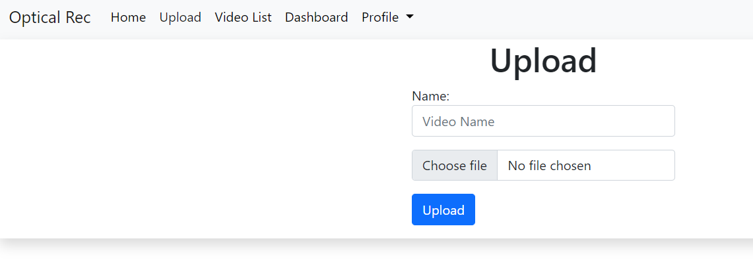
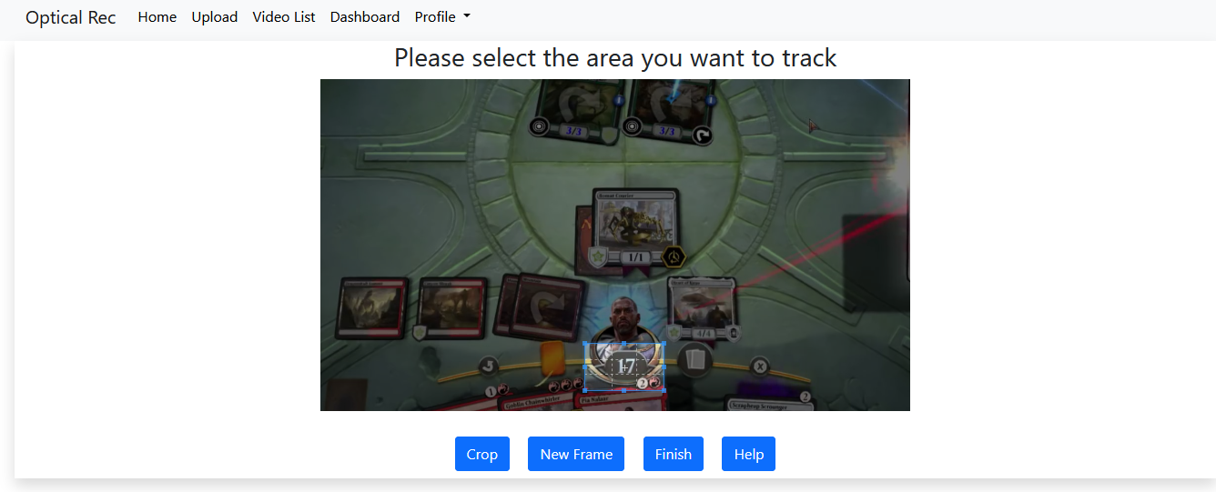
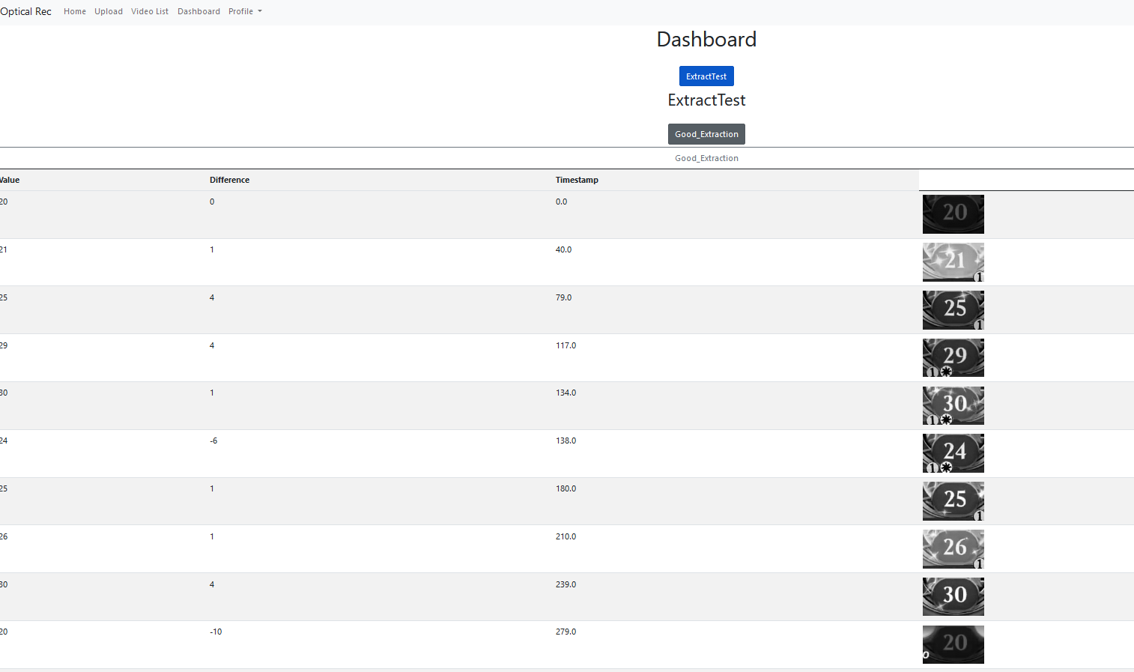
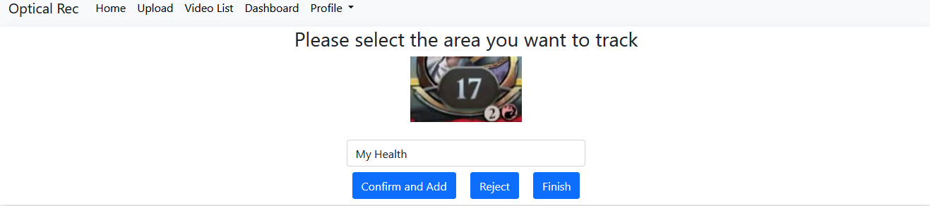
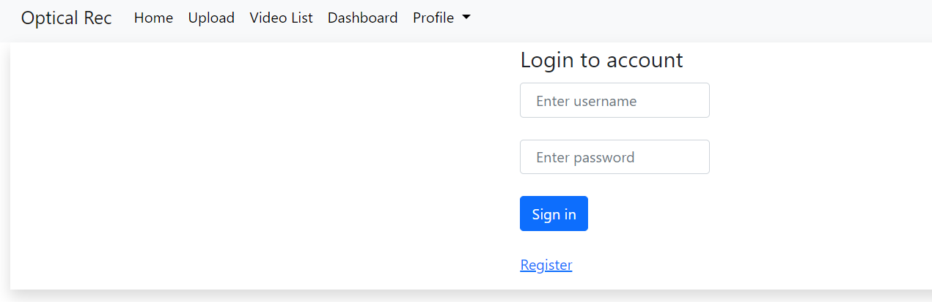
The general purpose of the system
Evidenced of how we met those requirements:
To create a dashboard so that a non-technical person can use the system.
To allow the user to upload their gameplay footage onto the system.
Extract key game data for it to be analysed later on in a dashboard.
To make sure the user can upload a video and identify key features from the game, and store that data in a database for further analysis
To allow the client to be able to scrape games data from games which do not provide this data through an API
Allowing the user to actually store all this information and look back at footages and the data received on them through dashboard

Slide 3

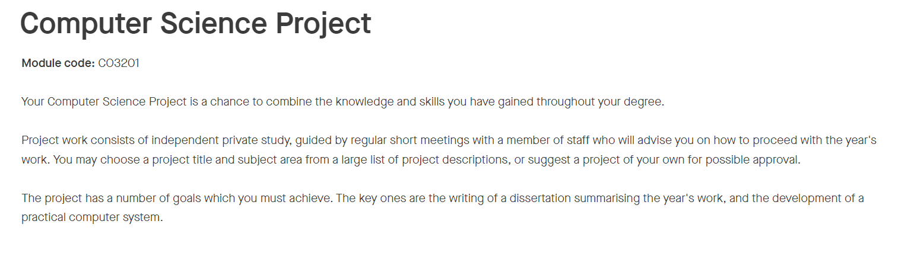
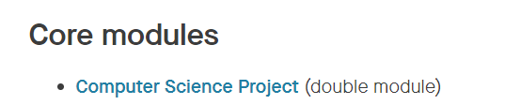

Other purposes of the project
A platform to help us in our final year project, to be able to develop further and give us an insight to what to expect in our final year project.
An experience worth mentioning in our CV’s when it comes to applying for internships, or even grad jobs upon graduating from the degree.
Such experience could be the difference of many candidates trying to apply for that one job were all trying to apply for.

Slide 4
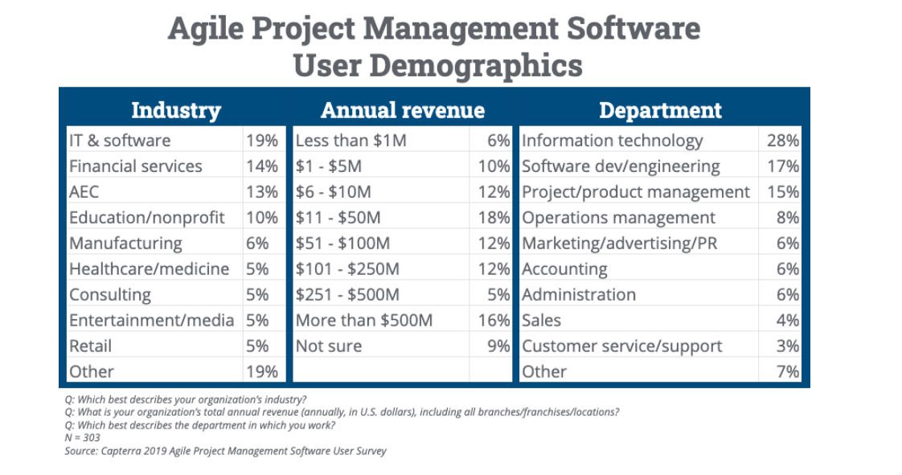
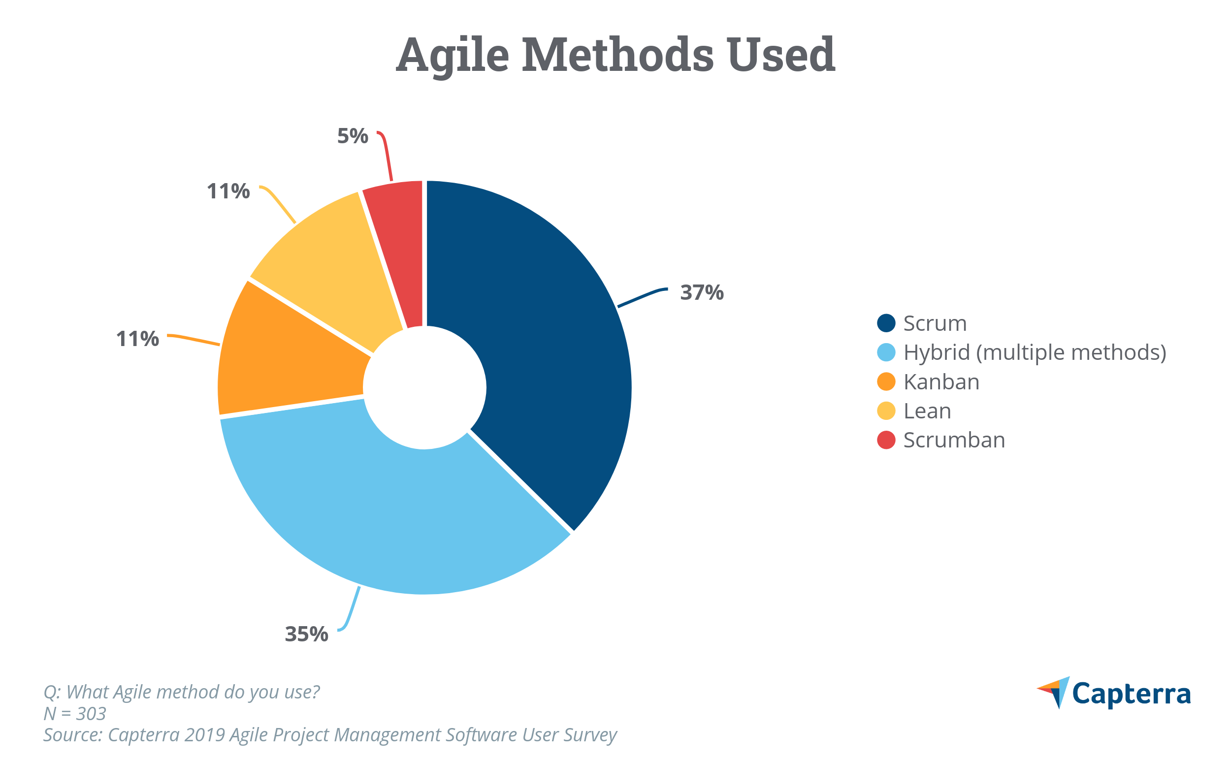
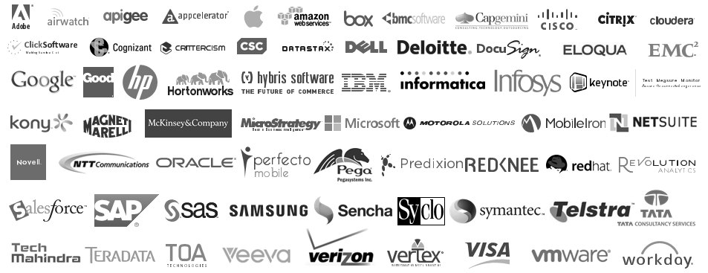
The importance of scrum to tech companies
Statistical information of how essential scrum/agile methods are to low and high end companies:
The wide range of low and high end companies that follow scrum/agile methodologies:

Slide 5
Overview of the purpose of the project
To produce a product that satisfies the clients need’s
Gain experience on how real world work is in tech companies
To provide us with something to put down on the experience section on our CV’s as a group.
Provide a platform for us to learn from when we finally start our final year project
Conclusion
I would say that there were some set purposes from the start but as A group I don’t think we were aware of the other purposes that came with getting to the end of the project
Thank you for listening

Slide 6




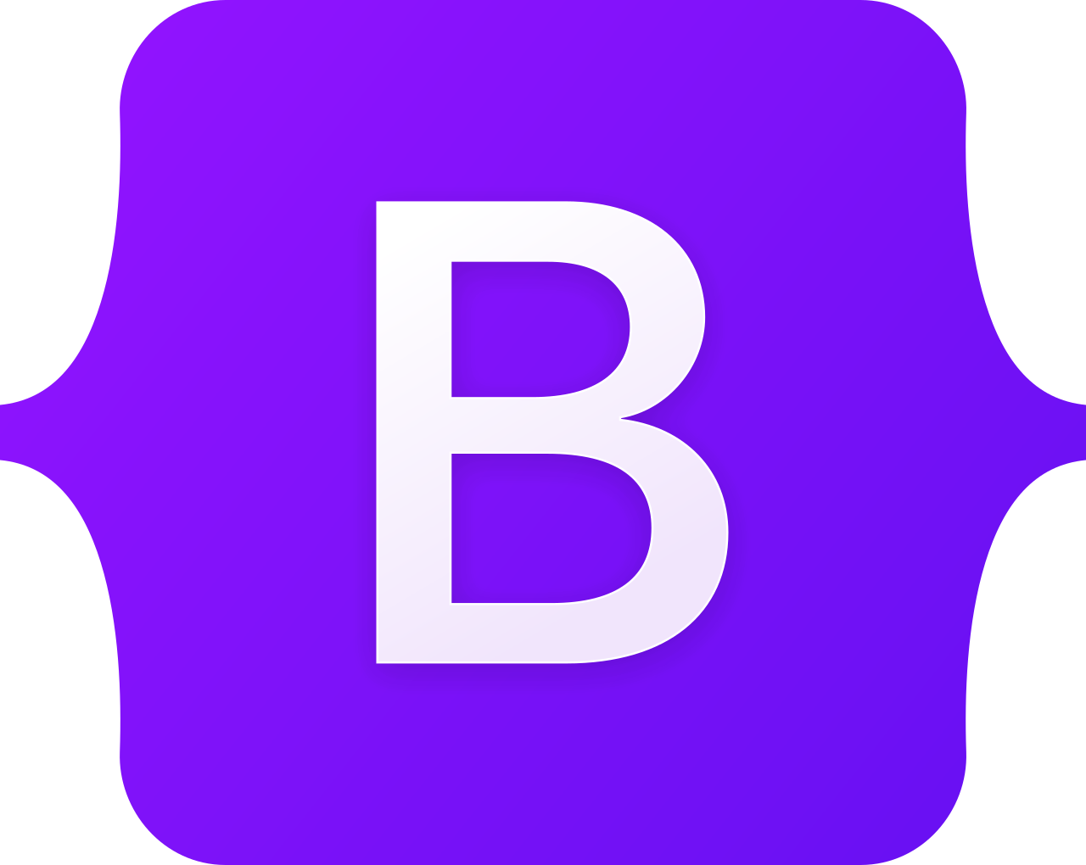
Project Software Architecture
https://www.djangoproject.com/
https://html.spec.whatwg.org/
https://www.python.org/
https://getbootstrap.com/

Slide 7
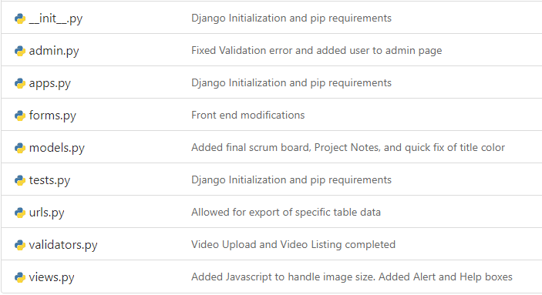
Why Django?
- Needed to work with Python for TensorFlow
A customisable, diverse Python framework
Quick website setup out of the box
Provides admin overview

Slide 8
Why Bootstrap?
Easy and quick implementation
Handles large portions of both HTML and CSS
Out-of-the-box templates for CSS

Slide 9
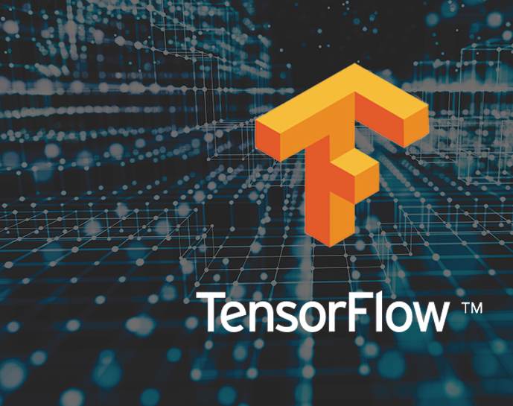
Image Classification
Using TensorFlow to classify digital values
Group 10
Zachary Larsen

Slide 10
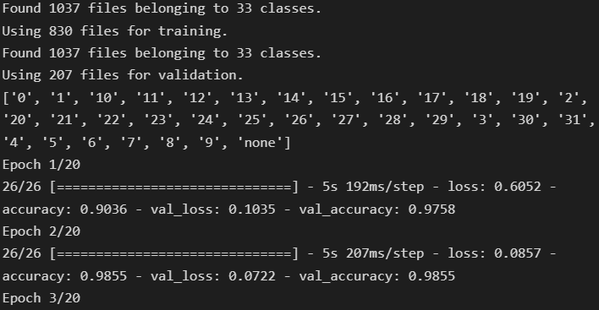
TensorFlow Model Training
Training a TensorFlow model using a custom Dataset.
We have 1000> images to use.
800> are used to train the model
200 are used to validate the training.
We use 20 iterations to train.
Notes:
We were not able to find a pre-made digit dataset that would allow for accurate number prediction.
We created a custom dataset by extracting example data from various MTG Arena videos.
These datasets were organized into categories based on number value. These images were pre-processed and converted to grayscale to ensure uniformity. This was fed into the TensorFlow training algorithm to train the model.

Slide 11
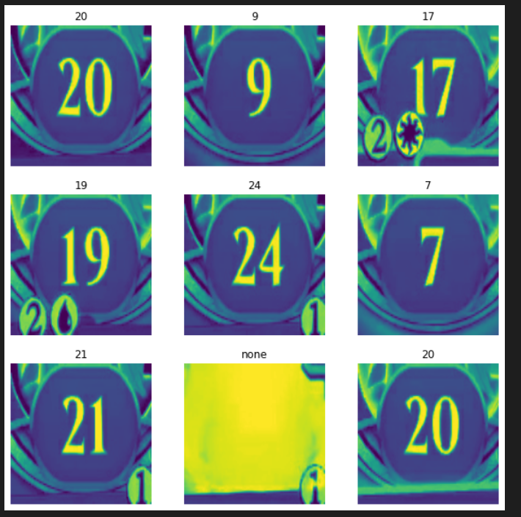
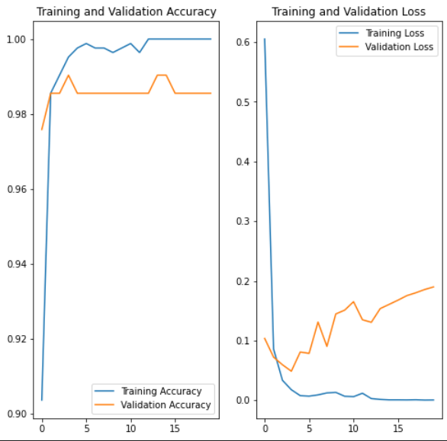
TensorFlow Model Training
Verification of Accuracy
Images are converted to Grayscale.
We are presented with 9 examples to visually check accuracy
Notes:
We were not able to find a pre-made digit dataset that would allow for accurate number prediction.
We created a custom dataset by extracting example data from various MTG Arena videos.
These datasets were organized into categories based on number value. These images were pre-processed and converted to grayscale to ensure uniformity. This was fed into the Tensorflow training algorithm to train the model.

Slide 12
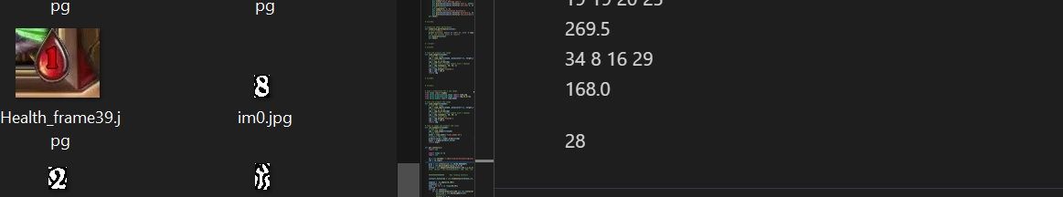
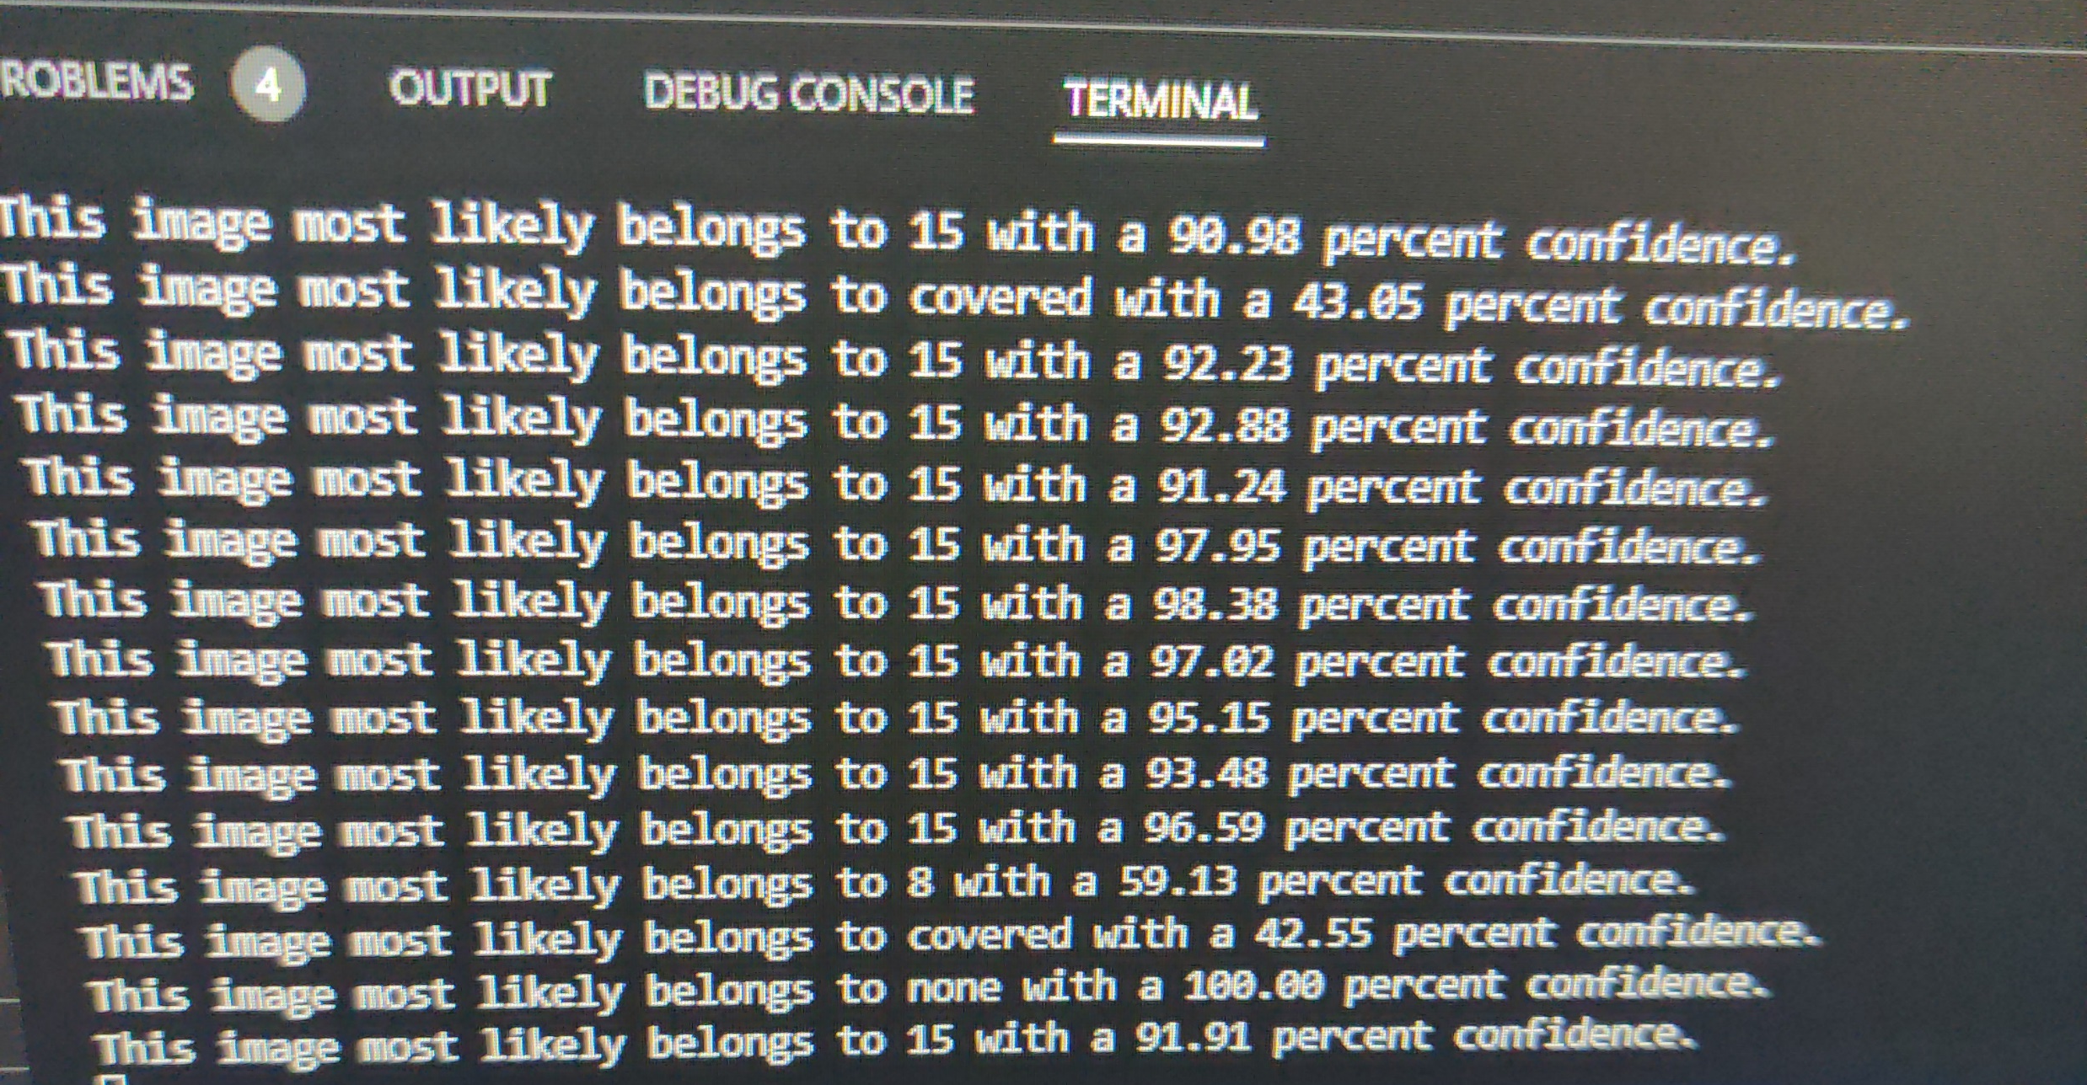
Model Testing
Model Testing took on many forms.
We tested various image examples to find what worked best.
We attempted to split double digits to predict on one digit only but found accurately extracting digits unpredictable.
The model is able to tell us how confident it is about a prediction.
This helped us determine bugs with the model when it would predict a wrong number.
Notes:
-We worked with various methods to try and ensure the greatest accuracy.
-Testing included:
- running terminal views to see the accuracy of the model.
- Trying to split numbers and predict on individual numbers.
- Running various MTG videos to ensure accuracy

Slide 13
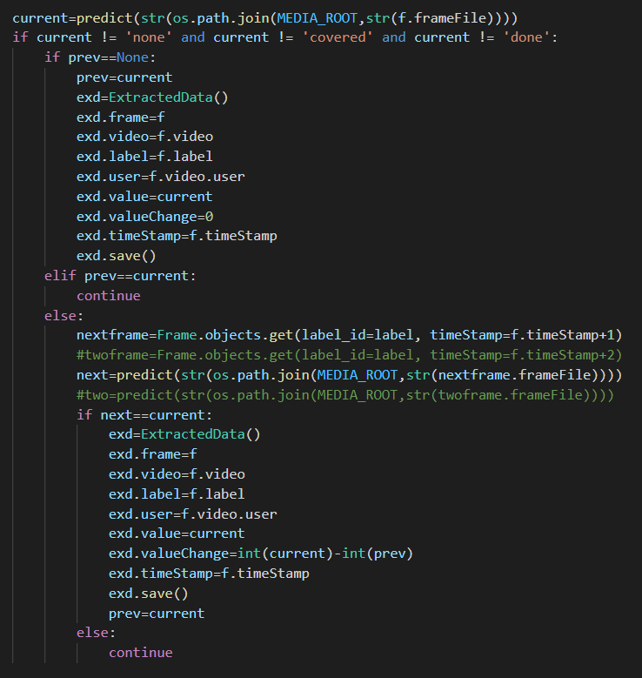
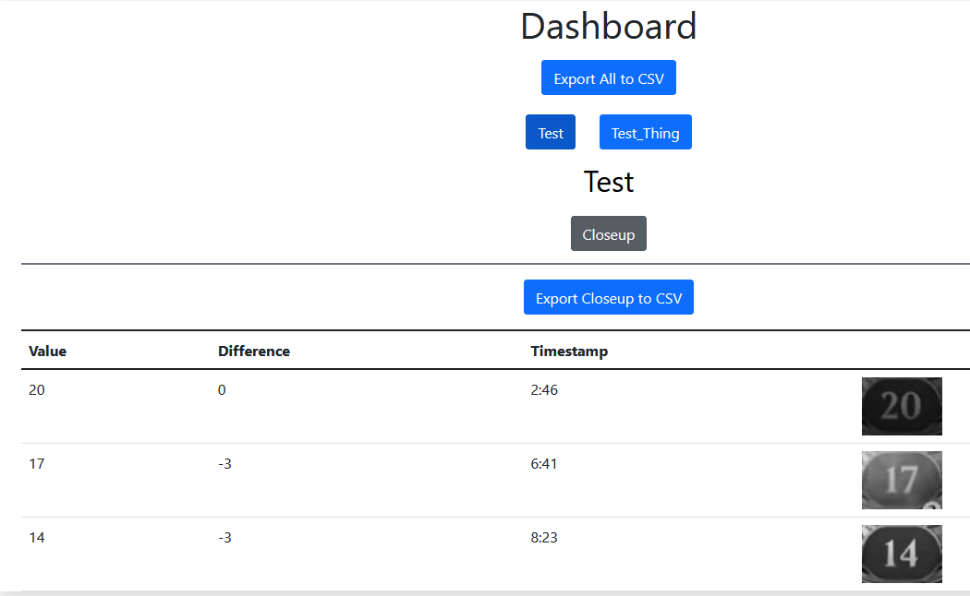
Implementation and Improvements
The user has total control of the data and can export any data requested.
By displaying the frame, the user can visually ensure accuracy of predictions.
Functions used to prevent false predictions.
By comparing predictions we can eliminate wild guesses by the model.
Notes:
Implementing the feature into the overall project allowed us to find other ways to help and improve the model.
We have given the user complete control over the data and extraction processes.
The model only saves information when there is a change in value. To prevent false predictions, we have implemented a function that compares the current prediction with the next prediction. As we are taking 1 frame per second, in most cases there will be at least 2 frames with the same number. By ensuring there are at least 2 frames we can reduce the number of times a false prediction is made.
- This approach could be improved. As there are times that the number may only be visible for 1 frame, these instances are ignored.

Slide 14
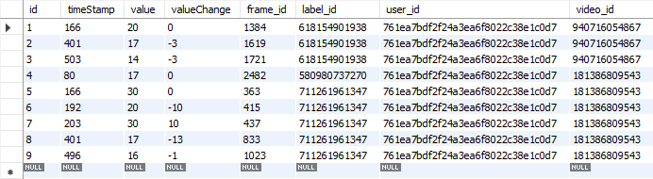
Data Storage
Frame Timestamp
Frame Foreign Key
Stored Label FK
Unique Data ID
Predicted Data Value
Change in Value
User ID FK
Video FK
Notes:
We store each extracted data with a Unique ID, Timestamp, Value, Change.
We link the extracted ID to a Frame (To get the frame image), Label (Health), User, and a Video.
These stored values allow us to tie the data to a specific user and video file. Only the user logged in with that ID can access the data.

Slide 15
Effectiveness of the tools used to communicate within the Group
Howard Kang
Group 10
Notes:
For this project, my group and I communicated through two types of communication, offline and online.

Slide 16
Offline
-Booked a meeting room
-SCRUM Meeting
-Do standups for each member
Pros
-Clearer
-Engaging
Cons
-Exclusivity
Notes:
For offline, we would select a date between the start and end of the sprint of two weeks, find a secluded meeting room, away from distractions, and discussed about the project. During each sprint, the Scrum Master opens the conversation and then followed by the others, conversing user stories and which they assign themselves to, the target deadline for each and potential issues that might follow. This works very well as we can understand more of each other’s point clearly and also nonverbal cues and also it was more engaging for us to enter the conversation.
However, when some members are not able to attend an in-person meeting, an online platform is the next best alternative.

Slide 17
Online - Teams
-When offline meeting isn't an option
-Help record SPRINT demo
Pros:
-Inclusivity
-Interoperability
Cons:
-Technical issues
-Organization
Notes:
For online, we would use two distinct types of communication platforms, Microsoft teams and Discord.
Teams
We used Microsoft Teams similar to how we conduct an in-person meeting.
We showcase each other our progress for our user stories, share each other for ideas and solutions. We also use Microsoft teams to record sprint demo, using only one screen and allowing other members to take control.
However, this method sometimes proves ineffective due to the dependence on internet connection and also the quality of the microphone and camera so that when we speak, we can be heard and seen clearly.
Sometimes, it’s hard to organize each members when they are in turn to speak as visual cues is harder to catch in Teams.

Slide 18
Online - Discord
-Organize overall system
-Handling issues raised
-Finding place and time for meeting
Pros:
-Quick
-Easy
Cons:
-Ineffective for meeting
Notes:
We used Discord to organize each of our user stories in relation to the product.
Finally, we also utilize discord to raise issues while working on the user story. There, we share technical problems that we encountered and attempt to search for a solution together
Also, when we want to have a meeting or each sprint, we each provide available places and time until we reached a consensus on where and when to conduct the meeting.
Using Discord is effective in exchanging ideas, asking small questions and communicate progress more quickly.
Overall, we were able to communicate effectively with these three methods as each method advantages covers the other method’s disadvantages.

Slide 19

Social Legal and Ethical issues with Optical recognition in Online Games
Ikenna Nnaji
Group 10

Slide 20

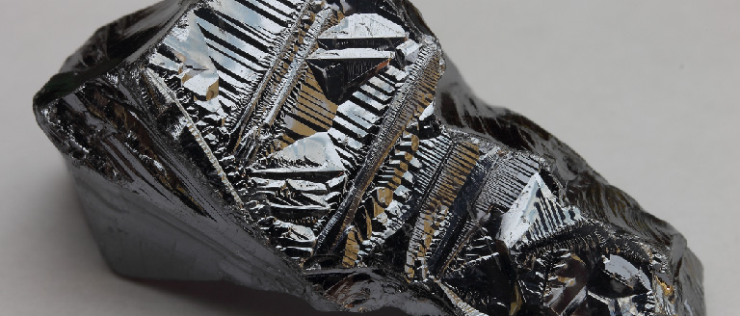
Gathering all that information can be very tasking and a big project especially when information from games are taking from multitudes of people. Getting all this information and storing it needs big facilities with servers and and this would expensive and difficult to maintain and there could be issues of rare raw materials used to build these servers and may not have been gotten in the most ethical way.

Slide 21

Most times the software is used to gather enough information to see trends such as how fast people can finish a game or if people find it difficult to play the game from looking at the scores gotten overall. This can be used to boost how good a game is and to make improvements which is a good thing for the gaming company but on a large scale it may affect the increase of gaming worldwide and increased gaming can lead to mental health issues when kids for example spend too much time indoors gaming due to its addictiveness and can cause social issues when they can’t communicate or live normally in society and could possibly lead to depression and in worse cases violence and nuisance.

Slide 22

There could be social and ethical issues from gathering a large amount of data because the user’s information would be collected from each game and a portfolio can be created for either the user or company to curate, However the issue is if a business uses this technology to gather user’s information there is the issue of consent and whether the data is gotten appropriately. This data can be used to target the ads to thousands of customer on a large scale if the data is passed around and sold to other companies.

Slide 23
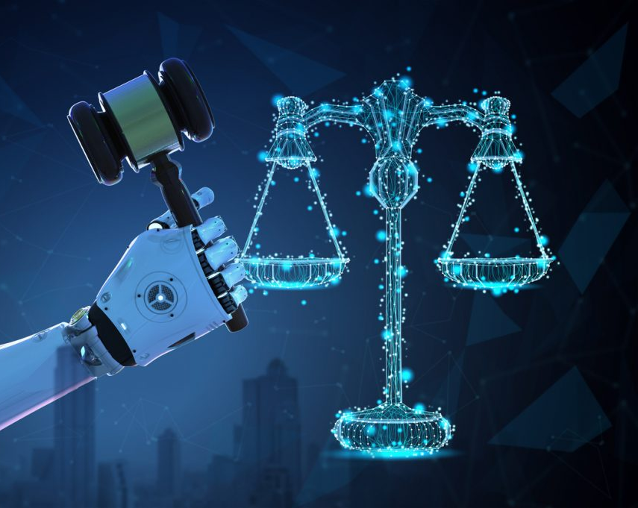
There could also be issues with the legality of the the data gotten. If the software is used by businesses especially and they use the information from a game there could be issues if the data gotten is used the wrong way. If anther game creator for example uses the data gotten from the software on a specific game, there could be huge similarities between the new game and the model game. If this is discovered the model game company can sue for an infringement of intellectual property and this can get very messy for not only the company that has used the software but even the software makers because it raises the question that they are allowing this to happen and could even possibly be selling the data directly to competing gaming makers with the highest bids.

